Slide 1
ANALYSING THE COVID-19 RISK FACTORS RELATED TO PREGNANT WOMEN AND NEONATES
Presented by-
Revathi S Nambiar

Slide 2
Presentation Outline
Introduction
Problem Statement
Literature Review
Proposed System Architecture
Implementation
References

Slide 3
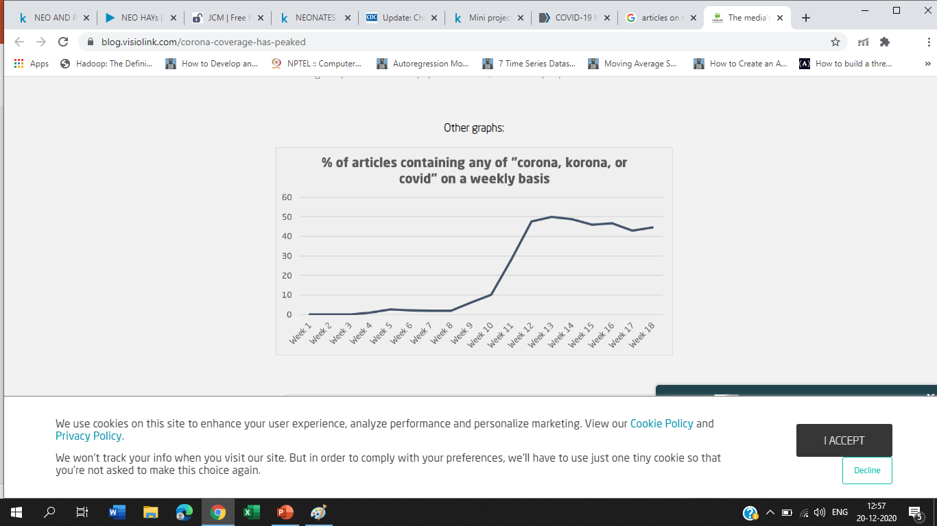
Introduction
The global pandemic has made it more important than ever to quickly and accurately retrieve relevant scientific literature for effective consumption by researchers in a wide range of fields.
Prominent journals have opened publications to the public in an effort to absorb and use the overwhelming amount of COVID-19 scientific literature.
Source - https://blog.visiolink.com/corona-coverage-has-peaked

Slide 4
PROBLEM STATEMENT
Analysing the covid-19 risk factors and preventive measures related to pregnant women and neonates to Reduce the Spread and fatality rate of Novel Corona Virus using different Text Processing methods and QnA system from Related Articles and Literature Reports.

Slide 5
OBJECTIVE
Analysis of the COVID literature available in scientific databases such as PubMed, Medline2,etc.
Extracting the Biomedical Entities that are involved in the literature using effective Named Entity Recognition (NER) algorithms.
Using State-of-the-art Neural models to learn and extract such relations, by modelling them as classification problems, which can range from binary to multi-class classifications.
Utilizing the relation patterns to analyse the risk factors such as symptoms to identify the corona virus infection.

Slide 6
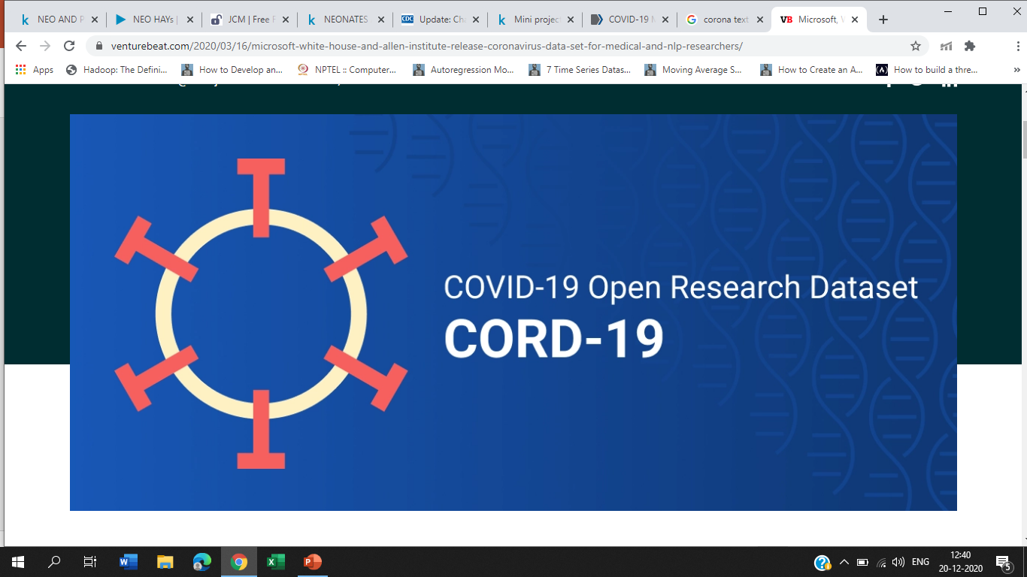
Dataset- (CORD-19 DATASET)
CORD-19 is the resource of over 200,000 scholarly articles, including over 100,000 with full text, about COVID-19, SARS-CoV-2, and related coronaviruses.
Includes two types of data namely metadata and full text articles, metadata consists of 19 columns which include information like authors, title, abstract, etc .
Processing this huge data was difficult in local Jupiter notebook and google colab as it just supports 13GB , so I used Kaggle notebook which is online execution platform.

Slide 7
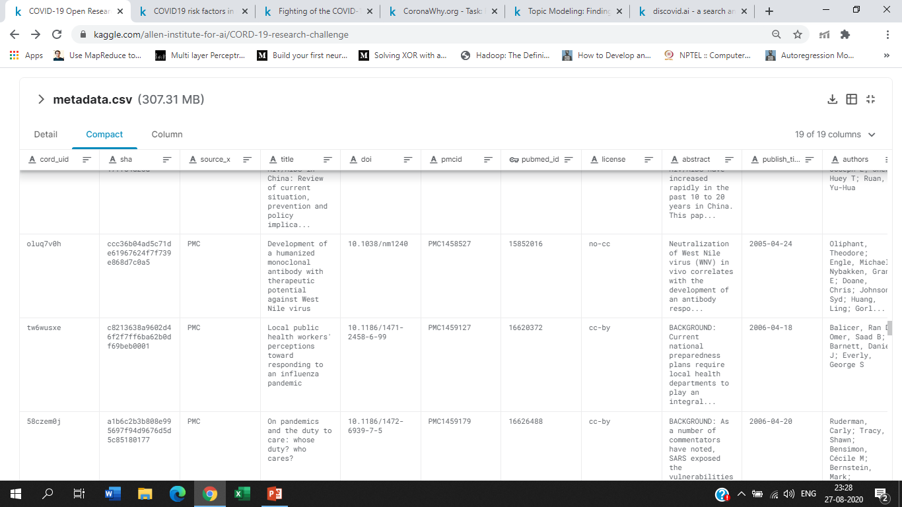

Slide 8
LITERATURE SURVEY
Journal/ Conference
ACL Conference
In European conference on information retrieval.
ACL Conference
TITLE | METHODOLOGY | FINDINGS
A Term Extraction Approach to Expert Finding on the COVID-19 Open Research Dataset | Saffron knowledge extraction framework to identify relevant expertise concepts in the domain-IDF | Implements expert finding through voting over automatically extracted terms from text.
A smart literature exploration environment for COVID-19 literature | Semantic Textual Similarity(STS). SciBERT, BioBERT | BioBERT was selected over SciBERT because COVID19 corpora include literature from other areas besides biological sciences.
Document Retrieval on the COVID-19 Open Research Dataset Using Topic Modelling | Non-negative matrix factorization (NMF), TF-IDF | Topic modelling-based approach provides great potential in serving in unsupervised, automated document retrieval for a set of well-defined tasks

Slide 9
LITERATURE SURVEY
Journal/ Conference
ACL Conference
In Asian conference on information retrieval.
TITLE | METHODOLOGY | FINDINGS
Question Answering tool for COVID-19 | Sentence-BERT model(filters out a subset of most semantically-related papers to an input query),BM25(for comparison). BioBERT ,SciBERT, DistilBERT (Tested for alternatives for question answering task) | DistilBERT was the best alternative ,although models trained on domain-specific corpora can better represent specific terms, the amount of training data is not enough to achieve comparable performances with respect to DistilBERT, which is pre-trained on a bigger general-domain corpus.
Continual BERT: Continual Learning for Adaptive Extractive Summarization of COVID-19 Literature | Novel BERT architecture built on existing techniques to learn and extract summaries from a continual stream of new tasks while retaining previously learned information. | The online training ability of Continual BERT enables adaptive learning on new data flowing in a time-sequential manner, especially fitting to the overwhelming amount of COVID-19 literature published on a daily basis.

Slide 10
LITERATURE SURVEY
JOURNAL/CONFERENCES
ACL conference
MedRix journal
TITLE | METHODOLOGY | FINDINGS
Searching Scientific Literature for Answers on COVID-19 Questions | NIR: Neural Index Run ,Bio B ERT-NLI model, RFRR: Relevance feedback with BERT-based re-ranking baseline | Hybrid index with both an inverted and neural index for ranking.
Self-supervised context-aware Covid-19 document exploration through atlas grounding | Bidirectional Encoder Representations from Transformers – BERT , Text-to-atlas mapping objective | It allows us to visualize medical text in physically meaningful space, finding clusters of documents organized by anatomy

Slide 11

LITERATURE SURVEY
JOURNAL/CONFERENCE
medRxiv and bioRxiv journals
ACL conference
ACL Conference
TITLE | METHODOLOGY | FINDINGS
Document Classification for COVID-19 Literature | DocBERT , BioBERT | Determine that fine-tuning pretrained language models yields the best performance on this task.
Collecting Verified COVID-19 Question Answer Pairs | Manually Aligning Additional Questions and Answers Aligning Extracted Questions with Existing Questions and Answers | Presented their growing dataset of over 2,200 question-answers that has been created by scraping over 40 websites.
Interactive Visualization and Simplified Pattern Discovery in the COVID-19 Open Research Dataset(CORD-19) | scispaCy, Scispacy Named Entity Recognition Model trained on the Bio Creative V Chemical-Disease Relations (BC5CDR) | Each of the data point in the text visualization, when clicked shows the text data in different contexts from the CORD-19 dataset.

Slide 12
TITLE METHODOLOGY RESULTS FUTURE WORK
SUMMARY OF LITERATURE SURVEY
Most of the papers published under CORD-19 dataset used text mining and analytics concepts like (NER,NERT,BIO-BERT, etc)
Most of the work carried out focused on developing Question Answering systems and Summarisers for different tasks under CORD-19.
Conceptual representation of documents using BERT, Sci- Bert where prominent among the representations.
Extractive and Query based summarisers, Clustering and classifying tools where developed.

Slide 13
TITLE METHODOLOGY RESULTS FUTURE WORK
Research Gaps and Challenges
Developments so far focused on the broader domain rather than one specific section of population ,example - high risk population.
Question answering systems and summarisers so far developed was not able to convey or capture the risk factors or Effective Modes of Communication to Reduce the Spread covid-19 .
Cord-19 is a huge dataset which requires Highly efficient processing machines.
CORD-19 is an evolving dataset , so each week new articles gets added therefore it is difficult to tackle the dataset.

Slide 14
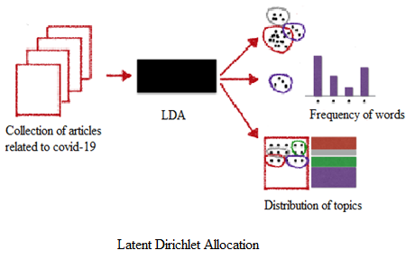
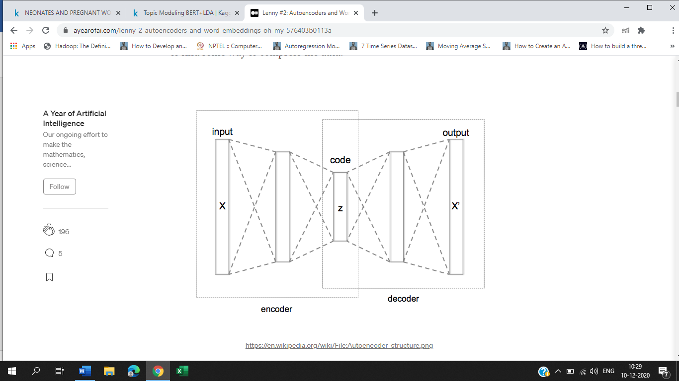
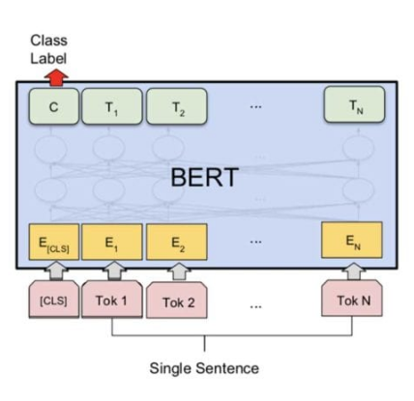
Proposed Architecture
QUESTION ANSWERING SYSTEM
CORD-19 ARTICLES
AUTOENCODER

Slide 15
Low Level Design
Sub setting the articles related to neonates and pregnant women
CORD-19 articles
Filtering cord-19 articles published on 2020
Pre-processing
Pos-tagging,
Lemmatization,
Punctuation removal
Vector Representation
Deep learning based Question
Answering System
Stop word removal ,
Lowercasing , etc..
Topic Modeling using LDA
BioBERT QnA
Auto encoding
Exploratory Visualization
Language Detection
Bidirectional Encoder Representation from Transformers
Farm-Hay Stack QnA

Slide 16
Question Answering Pipeline
Articles Related to pregnant women and neonates
LDA for probabilistic topic assignment vector.
Bert for sentence embedding vector.
High Dimensional and sparse concatenated vector
Autoencoder
Lower dimensional latent space representation of the concatenated vector.
BioBERT QnA
FARM-Haystack QnA

Slide 17
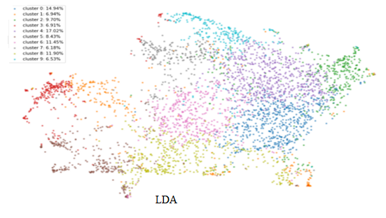
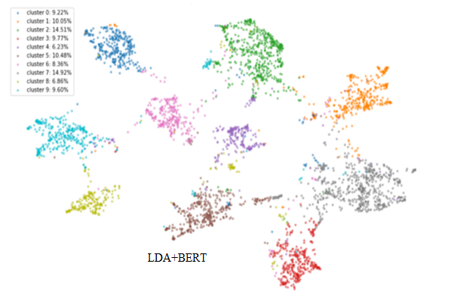
LDA vs LDA+BERT

Slide 18
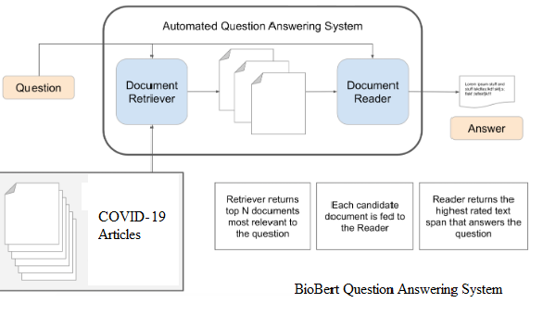
BioBERT Question Answering System

Slide 19
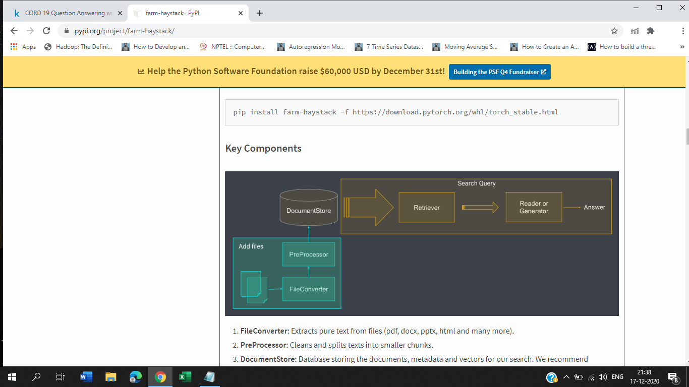
FARM-Haystack Question Answering System

Slide 20
FARM-Haystack
By this approach we can dramatically speed up the process that researchers have to follow when looking for answers to their questions.
Retrievers that speed up your queries and the APIs that allow you integrate this technology into your platforms.
NER systems need to know what entities you’re looking for, and document classification models need to be given examples of the categories you’re interested in. Neural search systems, by contrast, can start working for you straight away thanks to the recent advances in transfer learning.

Slide 21
FARM-Haystack
Retriever: Fast algorithms that identify candidate documents for a given query from a large collection of documents. Retrievers narrow down the search space significantly and are therefore key for scalable QA.
Reader: Neural network (e.g., BERT) that reads through texts in detail to find an answer. The Reader takes multiple passages of text as input and returns top-n answers.
Generator: Neural network that generates an answer for a given question conditioned on the retrieved documents from the retriever.
Finder: Glues together a Retriever + Reader/Generator as a pipeline to provide an easy-to-use question answering interface.
REST API: Exposes a simple API based on fast API for running QA search, uploading files and collecting user feedback for continuous learning.

Slide 22
TITLE METHODOLOGY RESULTS FUTURE WORK
Implementation Details
Imports and Loads
Exploratory Data Analysis
LDA + BERT Vector Representations.
Exploratory Visualization
Dimensionality Reduction
Question Answering System.

Slide 23
Conclusion
Topic Modeling with LDA alone was not able to capture the distribution of Topics efficiently , so had to move on for better vector representations using the pipelined architecture LDA+BERT.
Question answering using BioBERT dint not yield good result when compared to FARM Haystack QNA even though the pipelined vectors were provided as input.

Slide 24
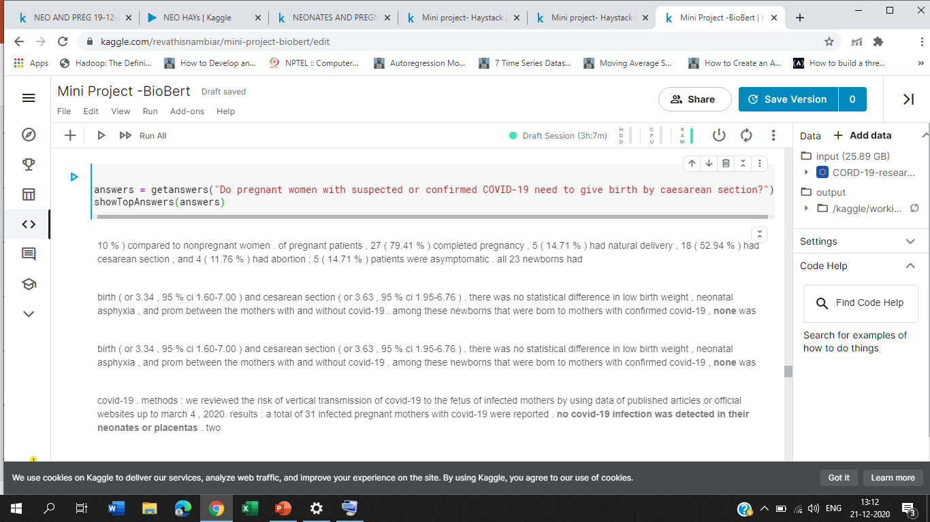
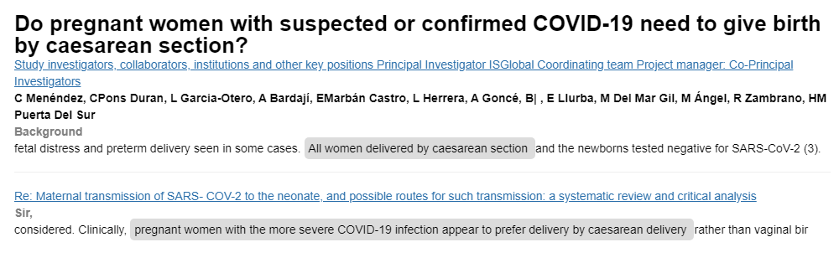
BioBERT vs FARM Haystack

Slide 25
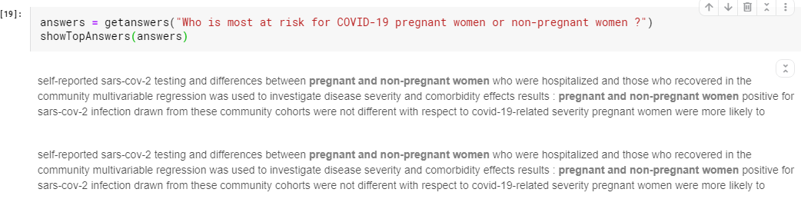
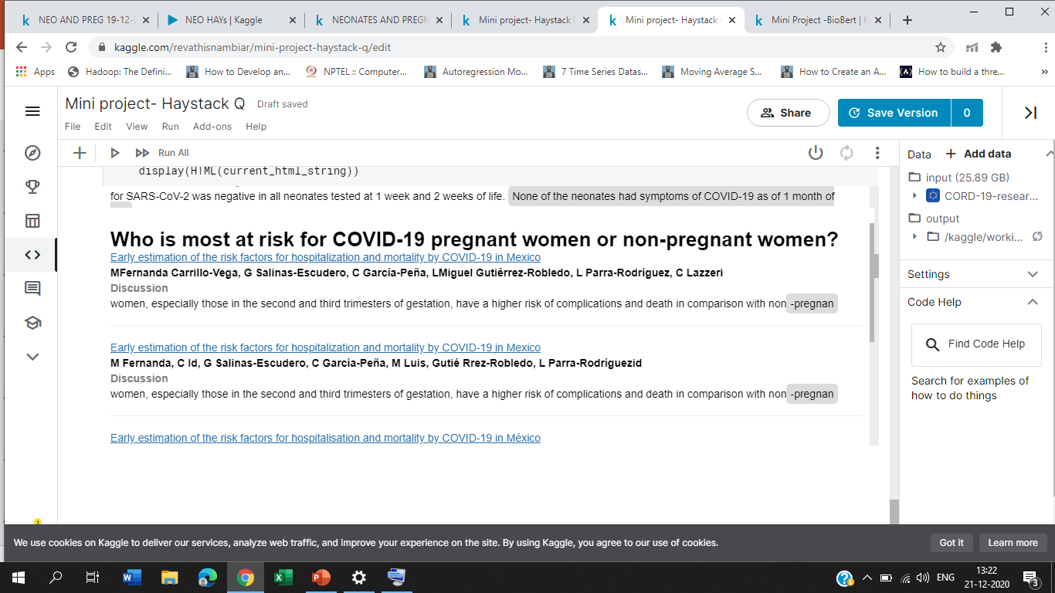
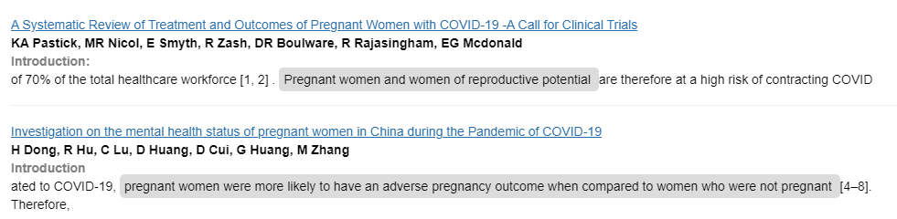
BioBERT vs FARM Haystack

Slide 26
Future Work
Addressing the other risk factors related to COVID-19.
Query Expansion using Fast Text Embeddings.
Using Extractive Summarizer instead of Abstractive Summarizer.

Slide 27
REFERENCES
Cécile Robin, Georgeta Bordea, Bianca Pereira, John Philip McCrae, Paul Buitelaar,” A Term Extraction Approach to Expert Finding on the COVID-19 Open Research Dataset“. ACL Conference, 2020.
Oscar William Lithgow-Serrano, Alejandra Lopez-Fuentes, Yalbi Balderas-Martinez, Fabio Rinaldi., “A smart literature exploration environment for COVID-19 literature’. In European conference on information retrieval, 2020.
Christine Herlihy and Yuelin Liu, “Automated Task-Informed Document Retrieval on the COVID-19 Open Research Dataset Using Topic Modeling”. MedRix journal, 2020.
Matteo Muffo, Aldo Cocco, Mattia Messina, Enrico Bertino, “Question Answering tool for COVID-19”. ACL Conference, 2020.
Wuraola Fisayo Oyewusi,” Interactive Visualization and Simplified Pattern Discovery in the COVID-19 Open Research Dataset(CORD-19)’. ACL Conference, 2020.

Slide 28
REFERENCES
Dusan Grujicic, Gorjan Radevski, Tinne Tuytelaars, and Matthew B. Blaschko,” Self-supervised context-aware Covid-19 document exploration through atlas grounding”. MedRix journal, 2020.
Bernal Jimenez Guti ´ errez, Juncheng Zeng, Dongdong Zhang, Ping Zhang, Yu Su,” Document Classification for COVID-19 Literature”. medRxiv and bioRxiv journals, 2020.
Adam Poliak, Max Fleming, Cash Costello, Kenton Murray, Shivani Pandya,” Collecting Verified COVID-19 Question Answer Pairs”. ACL conference, 2020.
Jong Won Park,” Continual BERT: Continual Learning for Adaptive Extractive Summarization of COVID-19 Literature”. In Asian conference on information retrieval, 2020.
Vincent Nguyen, Maciej Rybinski1, Sarvnaz Karimi Zhenchang Xing,” Searching Scientific Literature for Answers on COVID-19 Questions”. ACL conference, 2020.

Slide 29
Thank you

